Slide 1
Hydrogen Solution for Decarbonization (A) Job Report
Name:
Organization:
Country:
September 29, 2026

Slide 2
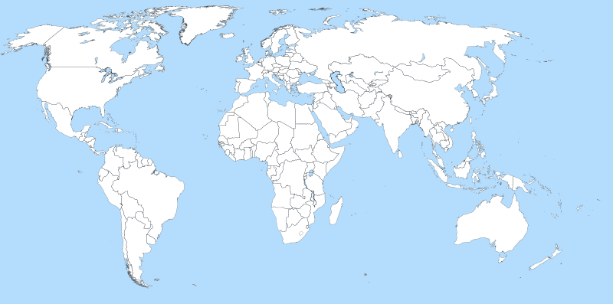
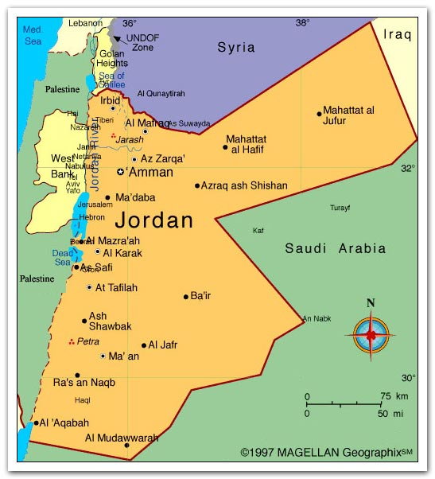
1. Outline of (your country )
▪ Area: km²
▪ Population: million
▪ Language:
▪ GDP: $ million
▪ Major industries
▪ Electricity charge: $/kWh
$ : private sector
（24\ in Japan)
$ : Industrial sector
(18\ in Japan)
One bottle of Coca-Cola (360ml)
$
(130\ in Japan)
Example

Slide 3
2. Energy Situation in (your country)
2-1 Primary energy supply mix
2-2 Energy self-sufficiency rate: 8%
Oil Equivalent
9712 ktoe
2-3 Final energy consumption mix
(by Sectors)
Example
2-4 Electric Power Supply Mix (by Sources)
Total
5,485 MW
Oil Equivalent
6761 ktoe
2-5 Electrification rate: 99.9%

Slide 4
2-6 Status of enactment or enforcement of laws or regulations promoting hydrogen use in your country.
1.Policy of promoting hydrogen use .
2.Target of promoting hydrogen use .
3.Regulation for promoting hydrogen use .
4.Progress of enactment or enforcement recent years.
5.Others

Slide 5
3. My organization & my job
3-1. Outline of Parent organization/Department
3-2. My main job
Main functions of your organization.
2. Explanation the task or roll of your organization in relation to Energy
Efficiency or Conservation.
3. Organization chart with your position (if possible as appendix)
1. Explain your roll or assignment in your organization.
2. Clarify your job to promote Energy Efficiency or Conservation.
3. Problem which you are challenging in your job related to Energy
Efficiency or Conservation.

Slide 6
4. Expectations for the training course
1.Your purpose of participating in this course.
2.Subjects of the course which you are interested in.
3.How will you apply skills or knowledges which you want to obtain
through this training course in your job related to Energy
Efficiency or Conservation.
4. Other matters which you are expecting to obtain from the course

Slide 7
５.Issue Analysis Sheet ( IAS)
No | Issues that I confront. | Actions that I am taking.
1 | Example: Insufficient national regulatory frameworks and technical standards for hydrogen energy deployment in Indonesia. | Example: We are currently conducting benchmarking studies on international hydrogen strategies, including Japan’s Basic Hydrogen Strategy and Australia’s National Hydrogen Roadmap. In parallel, we are working with relevant national ministries to provide technical input for the development of the hydrogen policy of my country
2
3

Slide 8
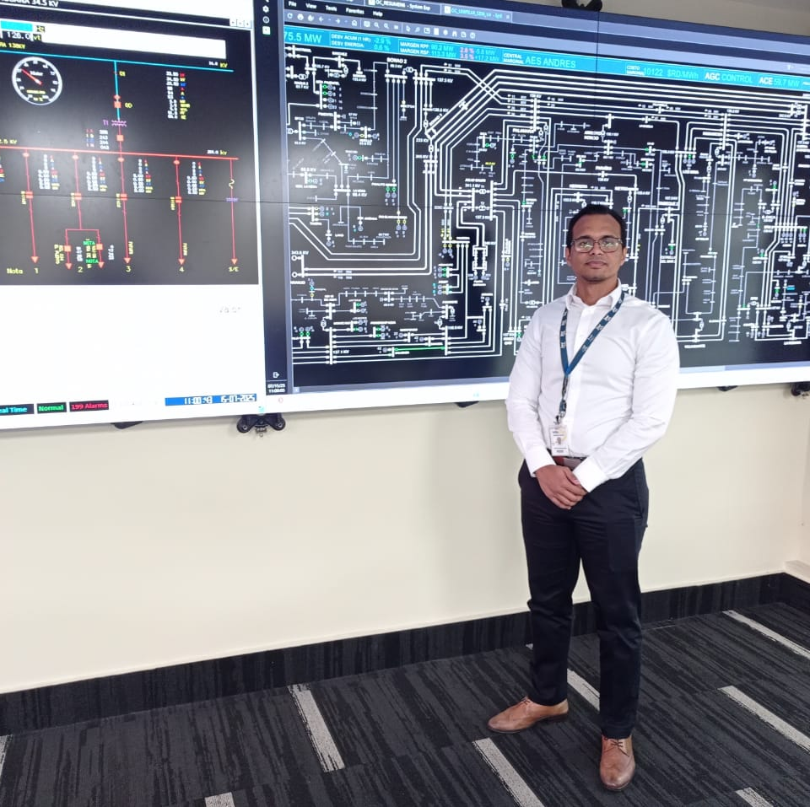
Thank you for your attention
me at work (Photograph)

